Slide 1

INFO 6150 - Web Design and User Experience Engineering Final Project Presentation
Harshini Venkata Chalam - 002934047
Kruthika Kolume - 002786400
Kshetra Hegde - 002728959
Pavan Soma Shekar - 002737038

Slide 2
About
FOODZILLA, is a one stop Web Application for all food enthusiasts where one can order food online, browse through various food recipes and make sure their leftover food is not wasted by added pick up details
It is MERN stack application which is configured on the server side by connecting Node.js and Express.js to MongoDB on the backend. The API built on react for user friendly interface is then connected to the backend
External API is connected to make online payments easy

Slide 3
Tech Stack
Front-End
React
Redux
Back-End
Node.js
Express.js
MongoDB (Atlas)
Firebase (Image Storage)

Slide 4
Flow
User Role
Browse through the menu for various food options by either choosing a food category or search-bar
Login to the account using the “Login” button or with the settings icon displayed on the left side bar
New users can create an account with the register option
Upon food selection, add the items to cart with the ‘+’ button
Use “Proceed to checkout” button to view all the items added to the cart and the price details
Continue the checkout by adding a new address or select an existing address
Complete the order by selecting the payment option between ‘Cash on Delivery’ or ’Stripe’
User’s can also access simple and quick recipes by navigating to ‘Tasty Recipes’ page through the side bar

Slide 5
Flow
Admin Role
Login to the account using admin credentials
As an admin the food items can be tracked regularly.
Items on the menu can be added, viewed, updated or deleted.

Slide 6
Screenshots

Slide 7
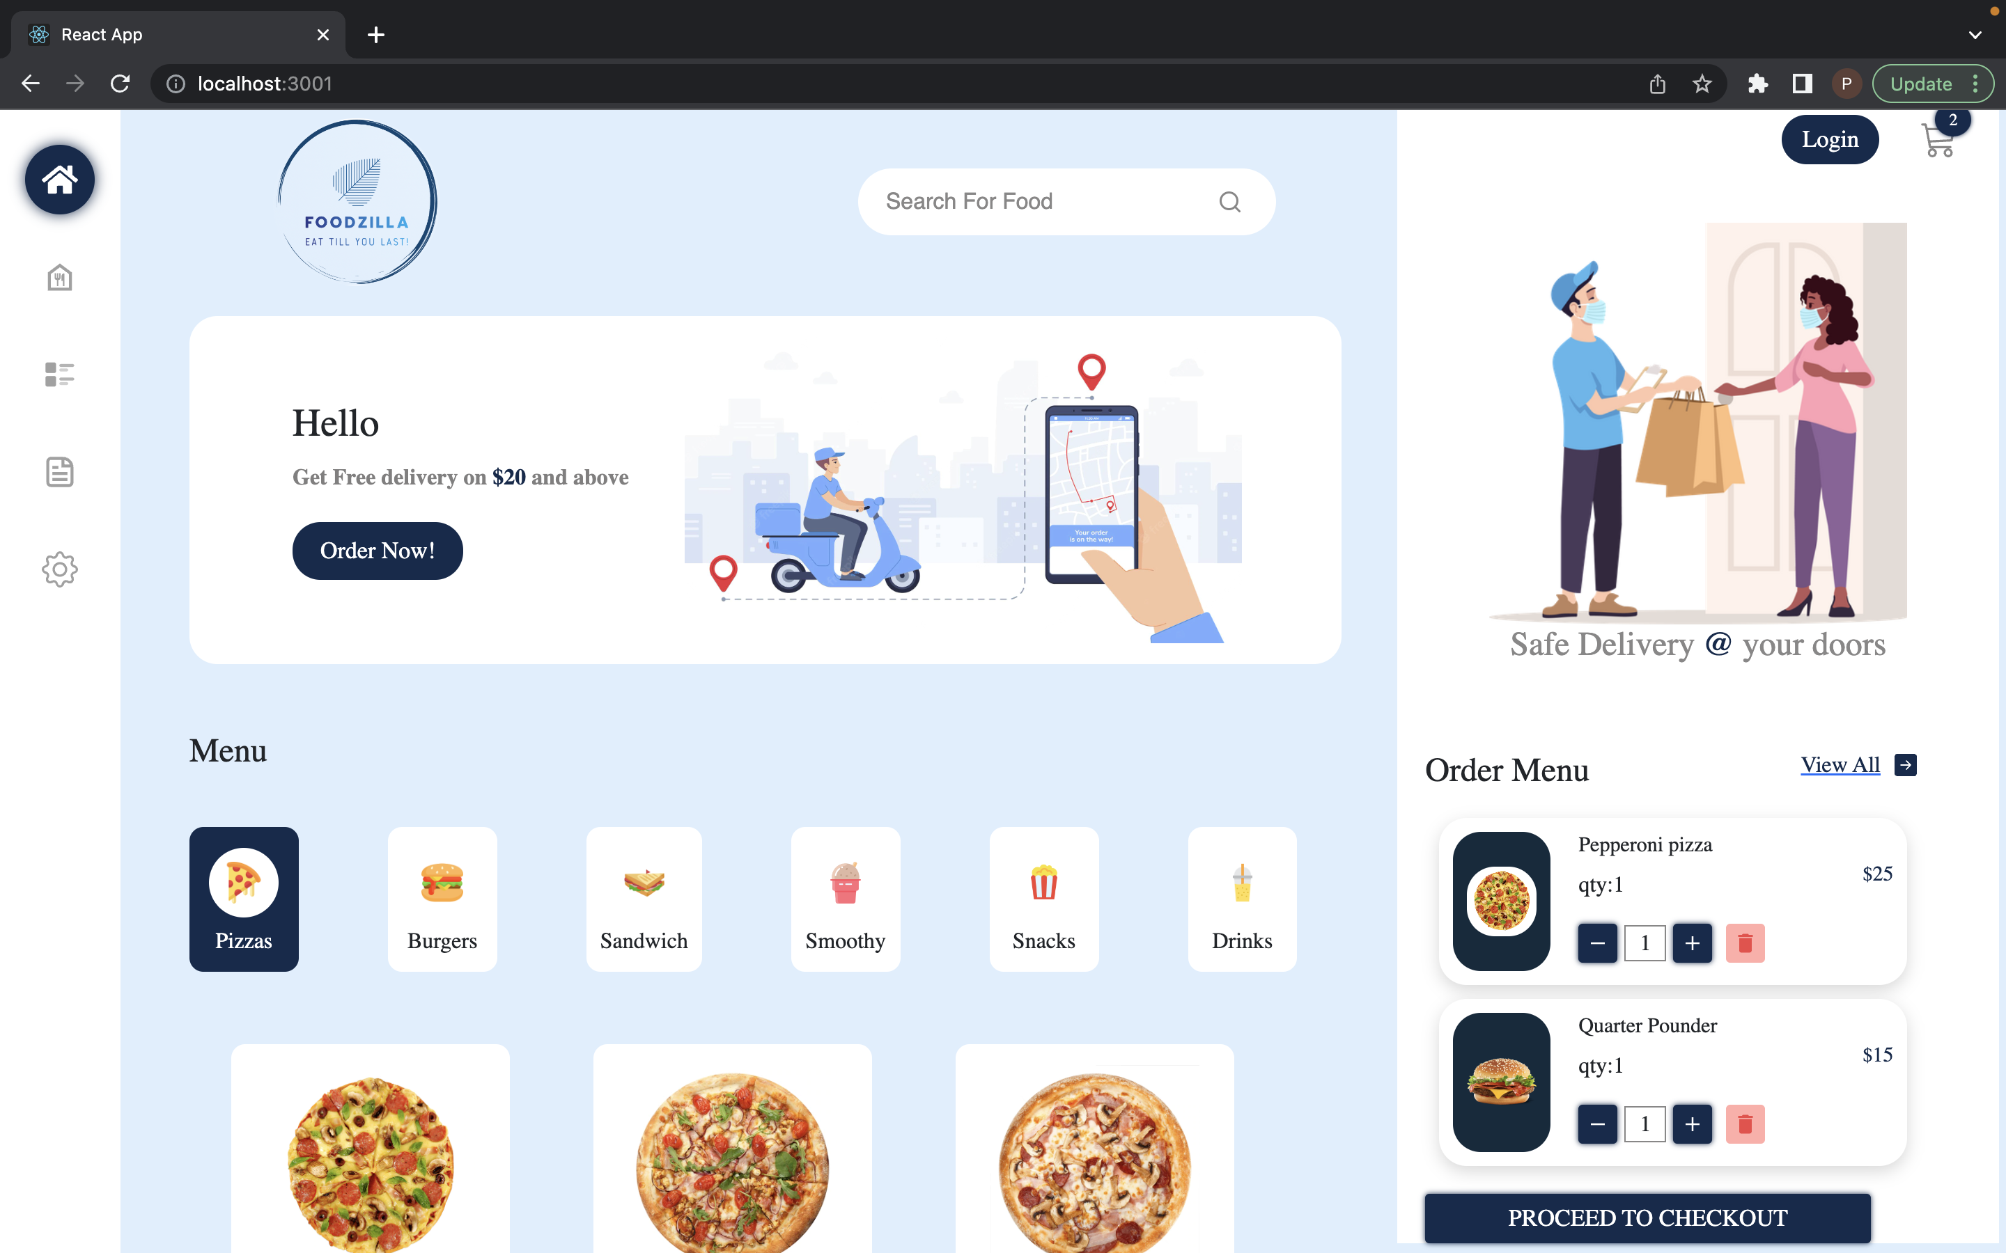

Slide 8
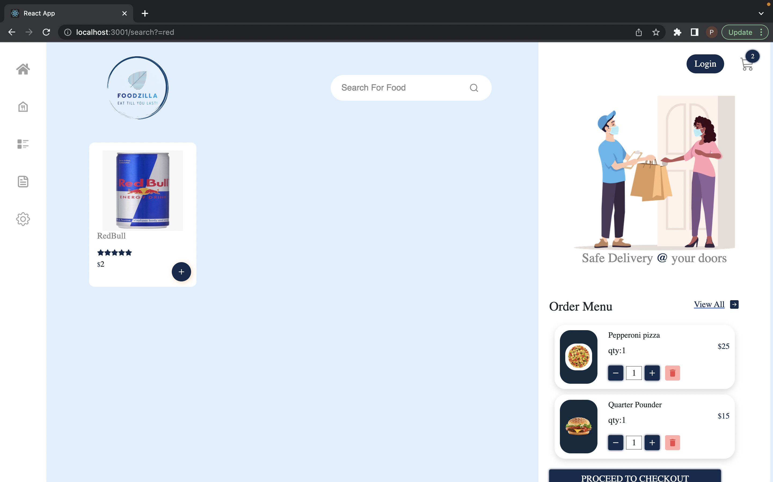

Slide 9
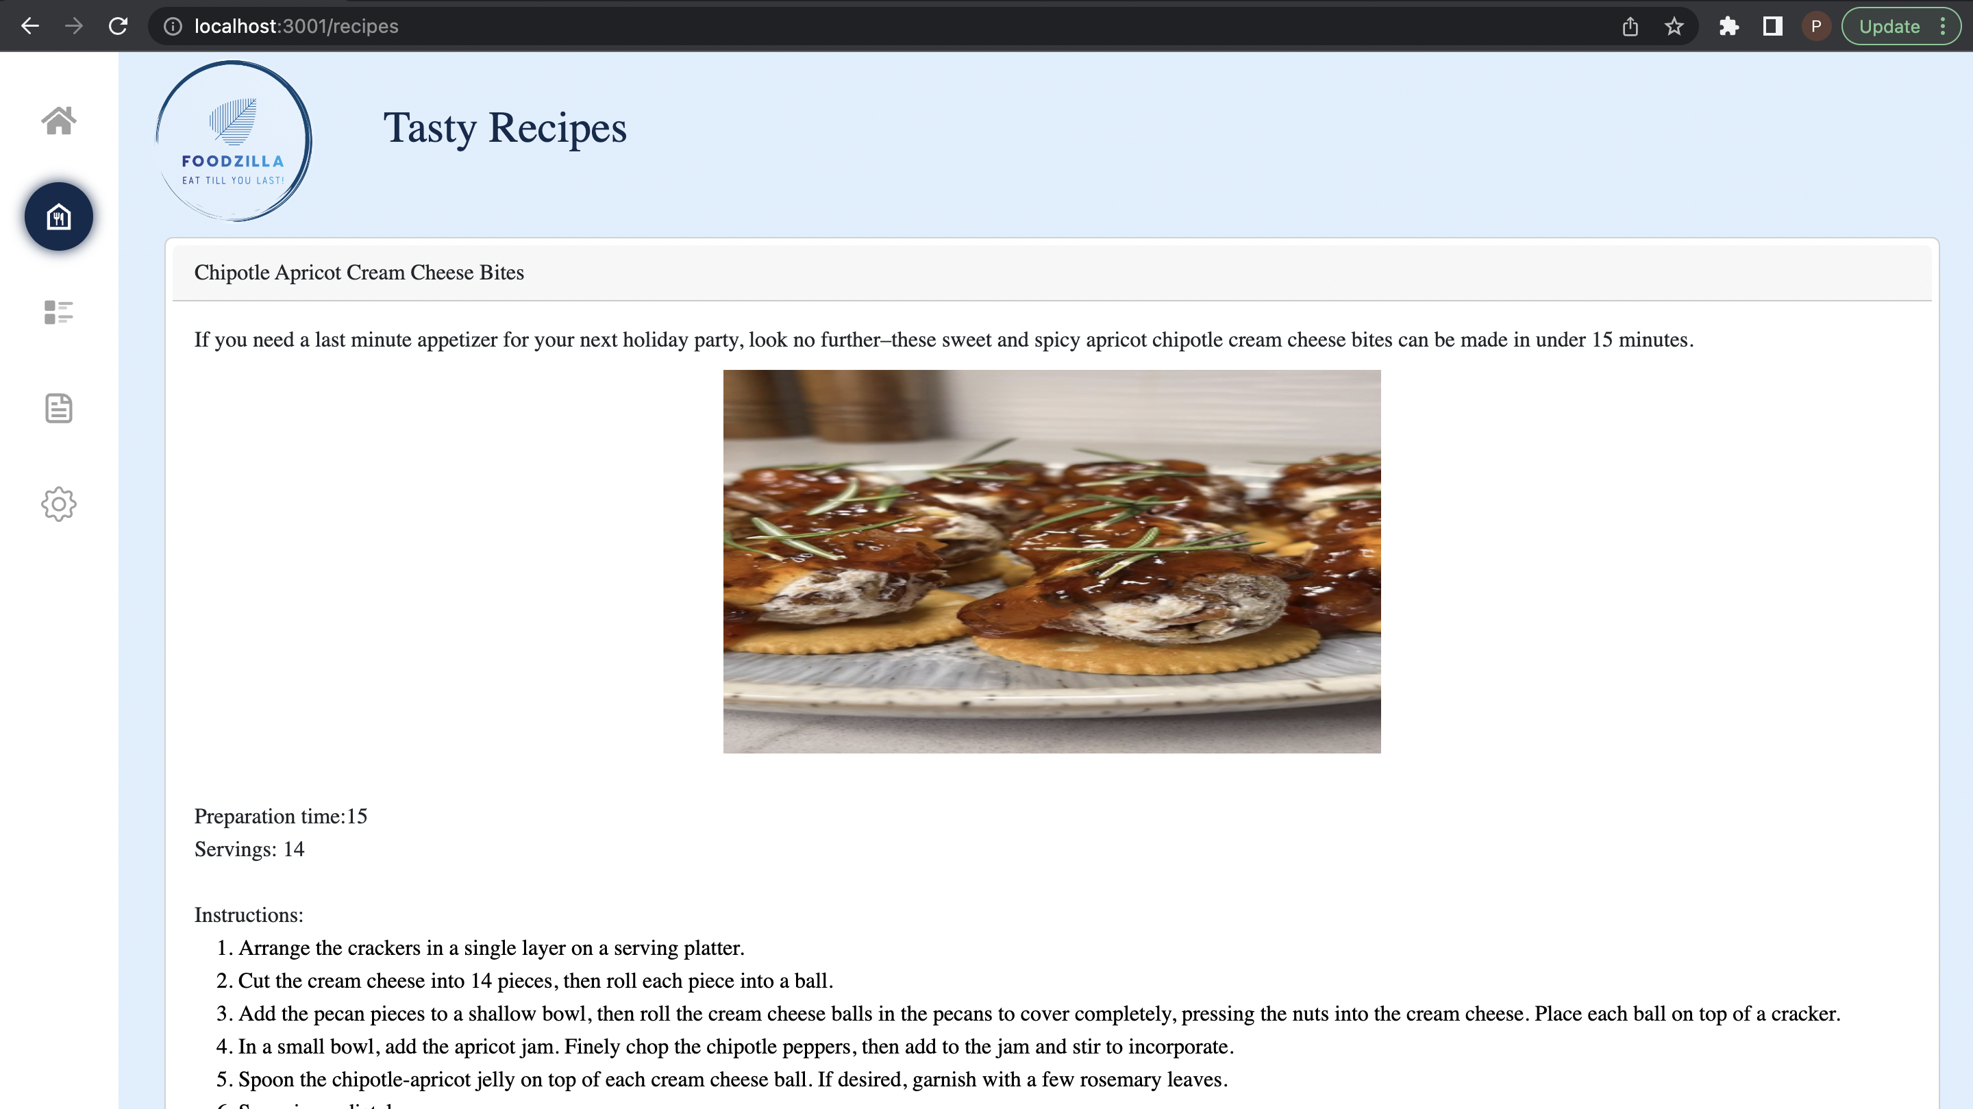

Slide 10
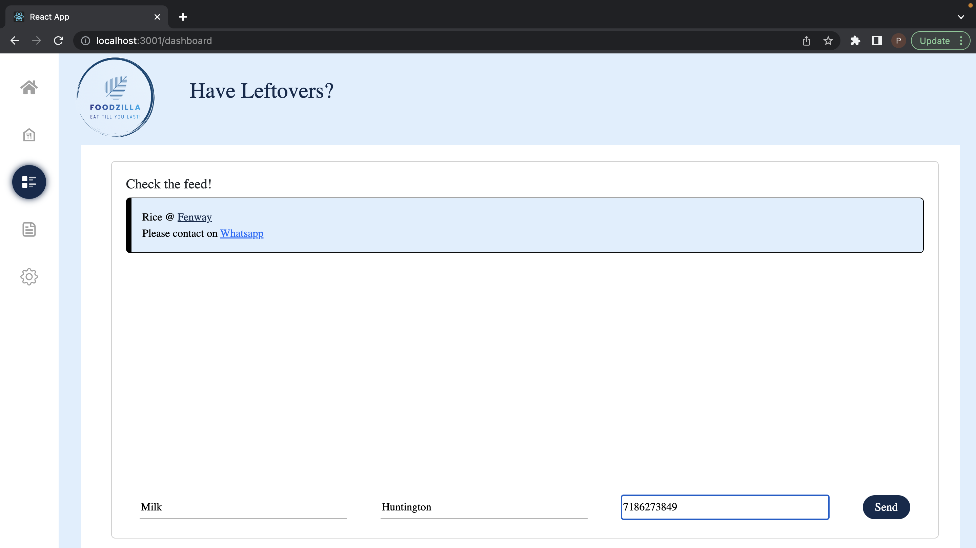

Slide 11
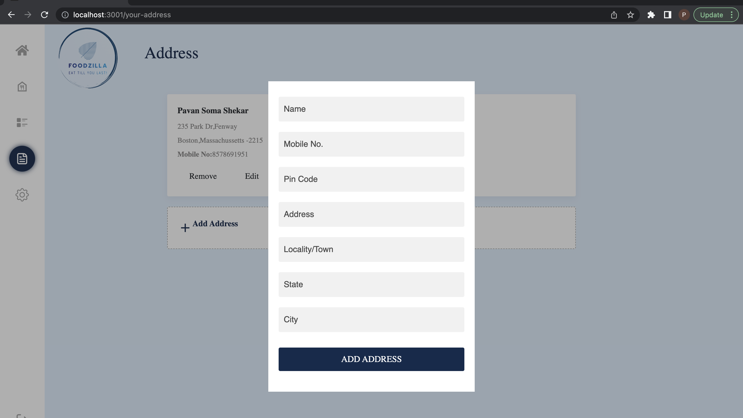

Slide 12
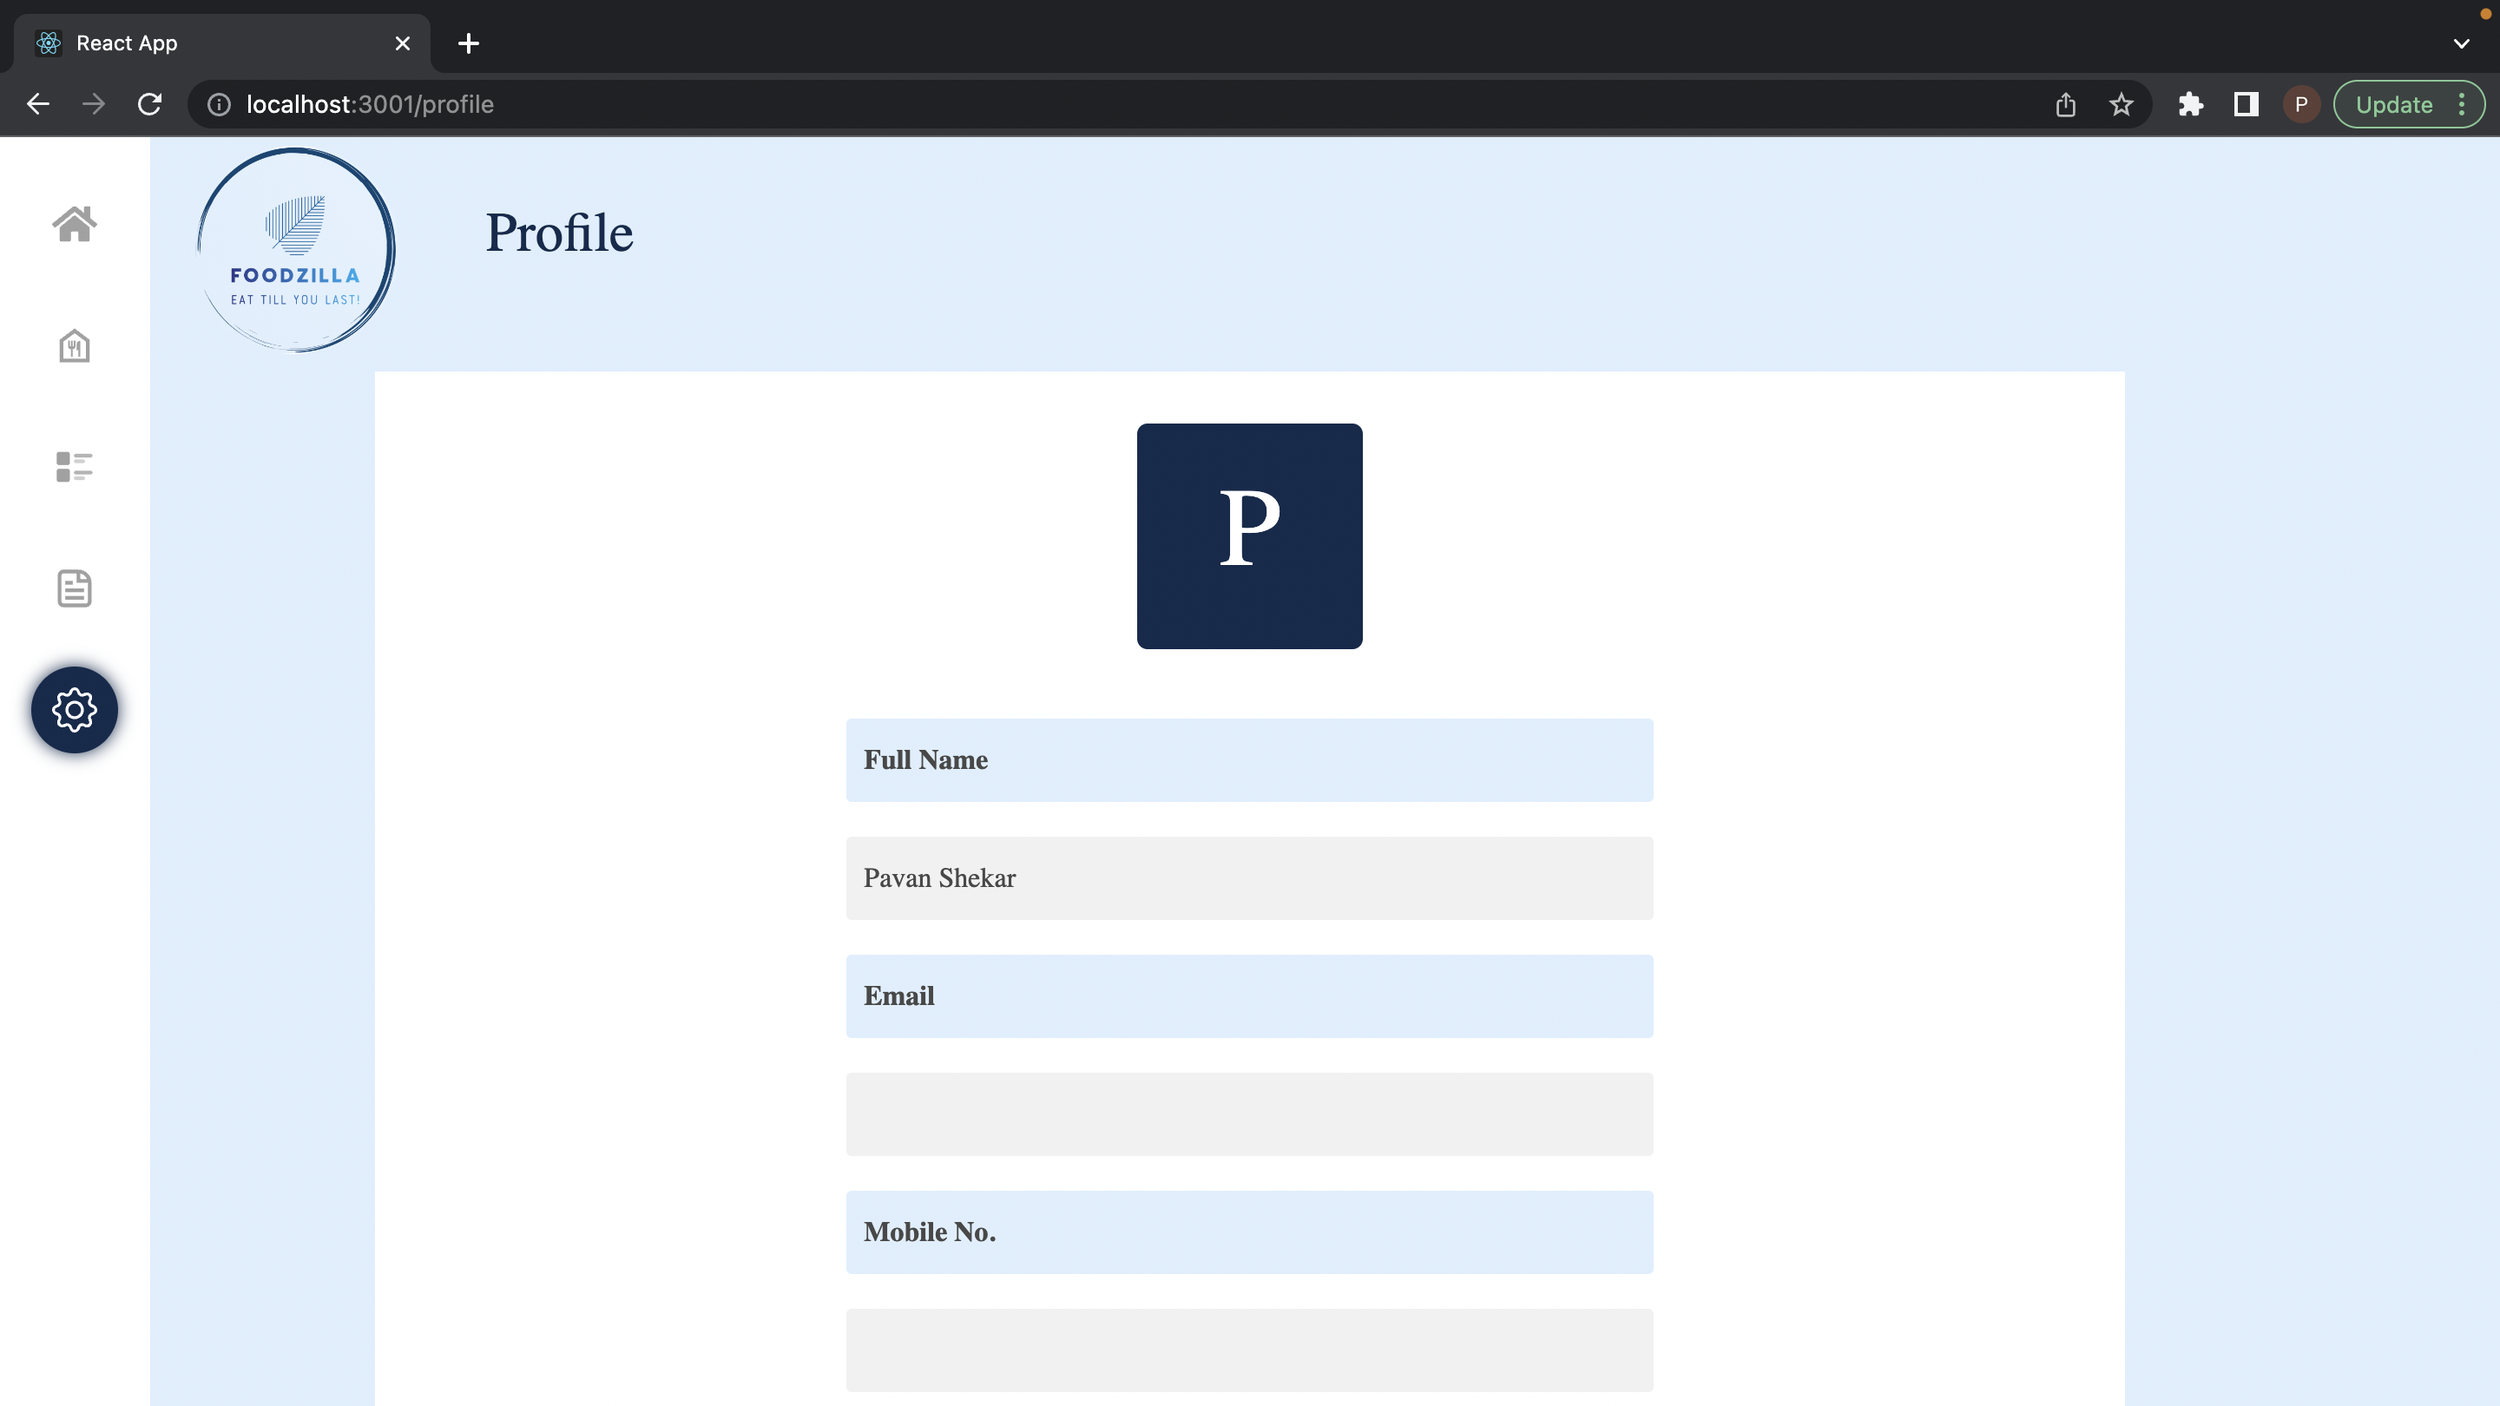

Slide 13
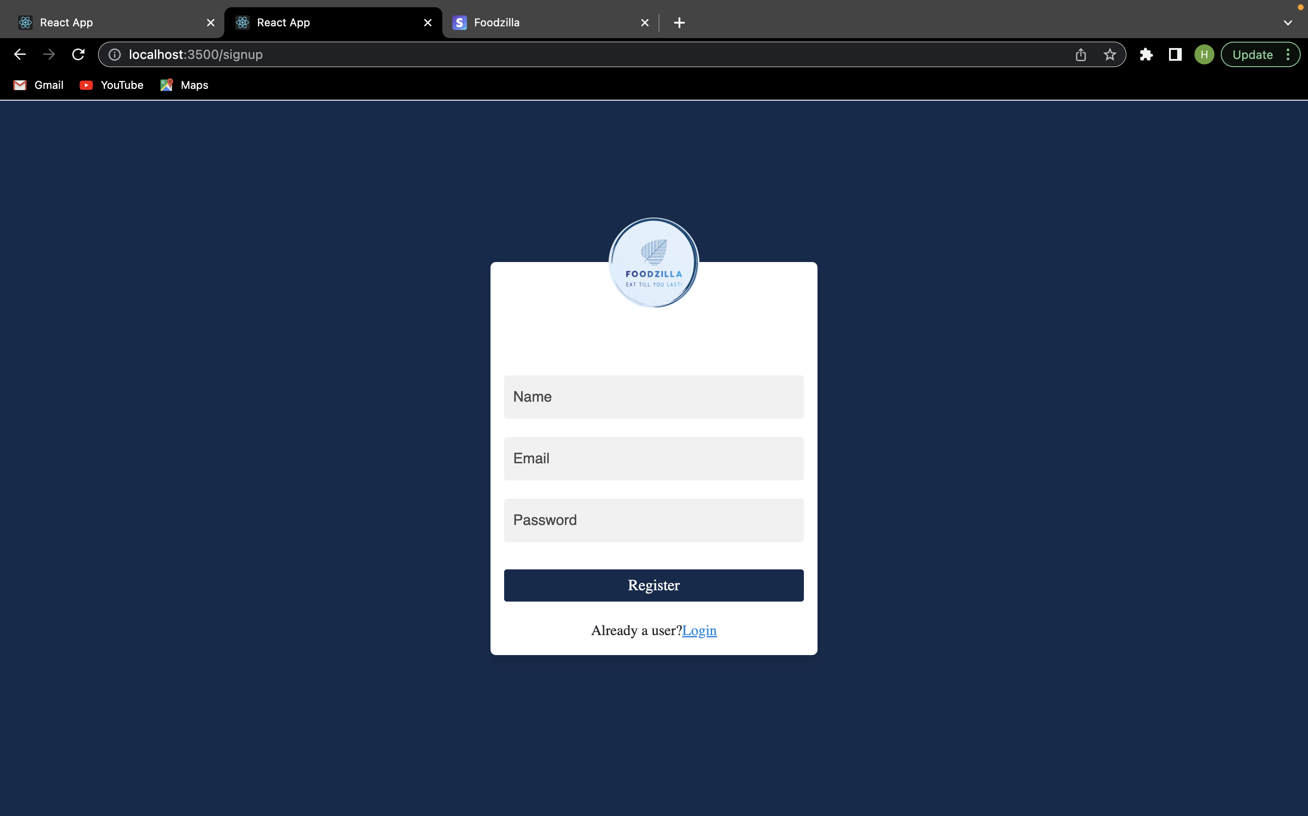

Slide 14
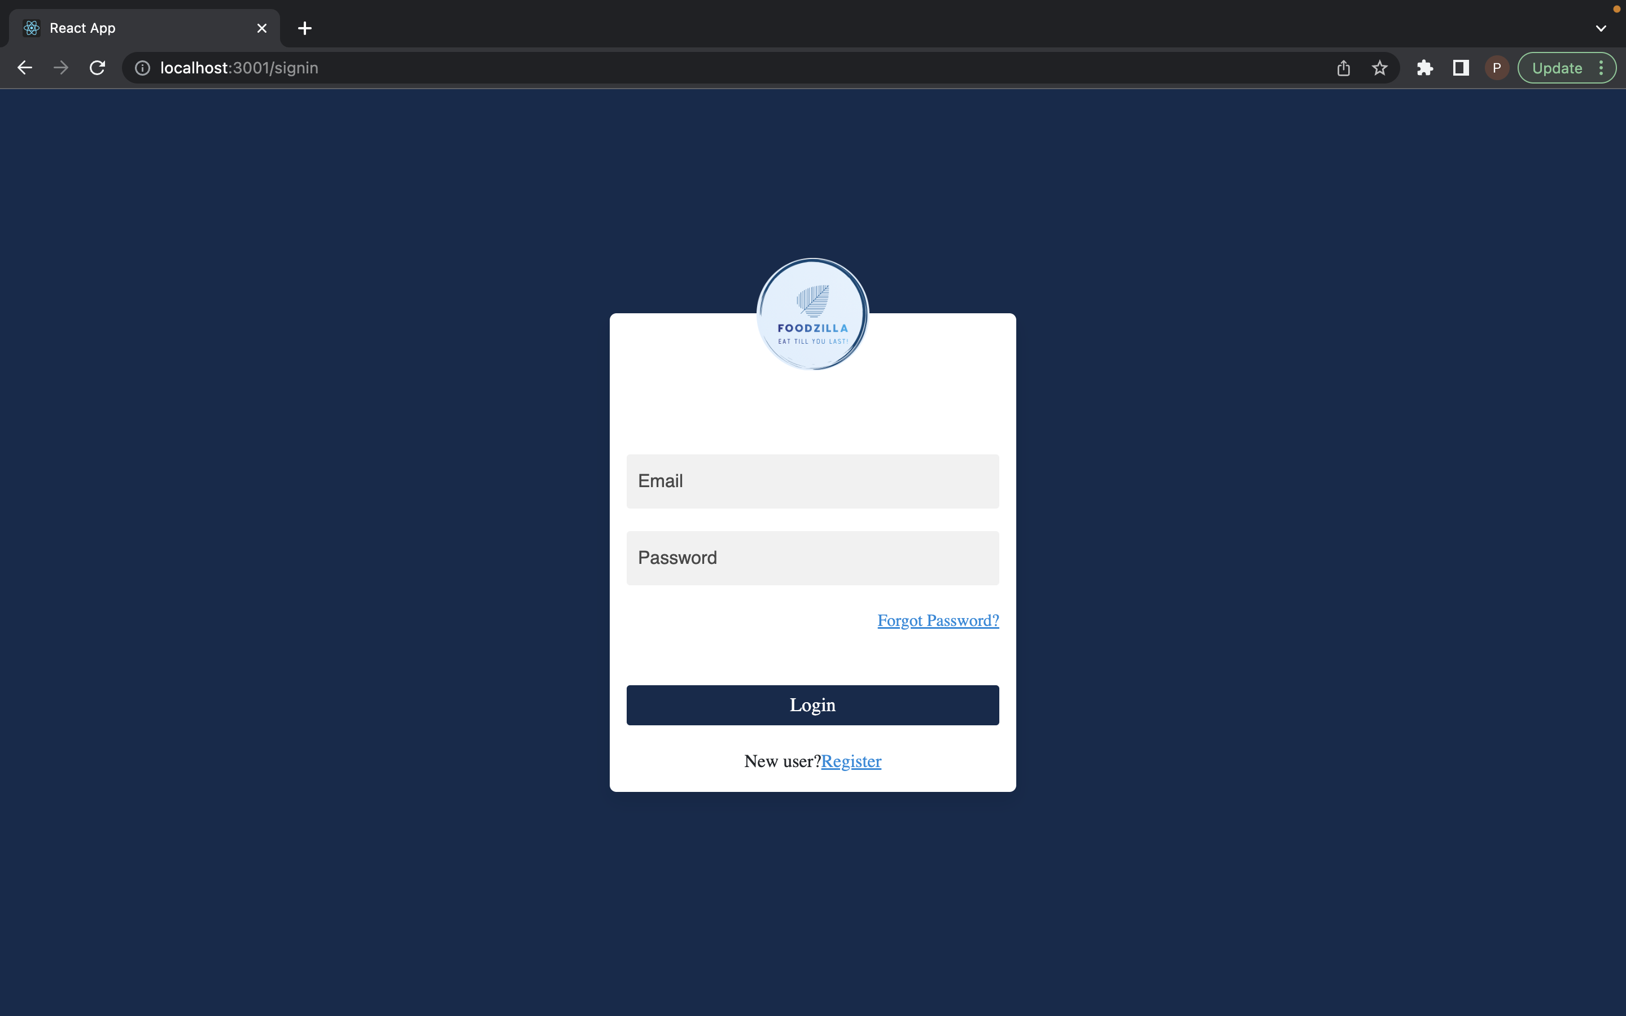

Slide 15
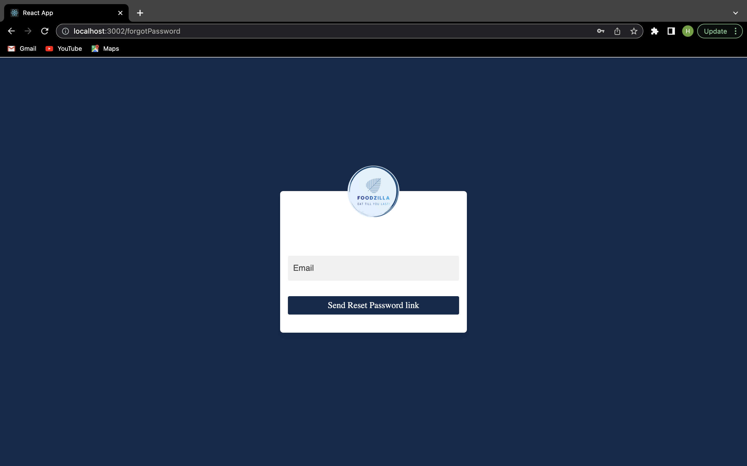

Slide 16
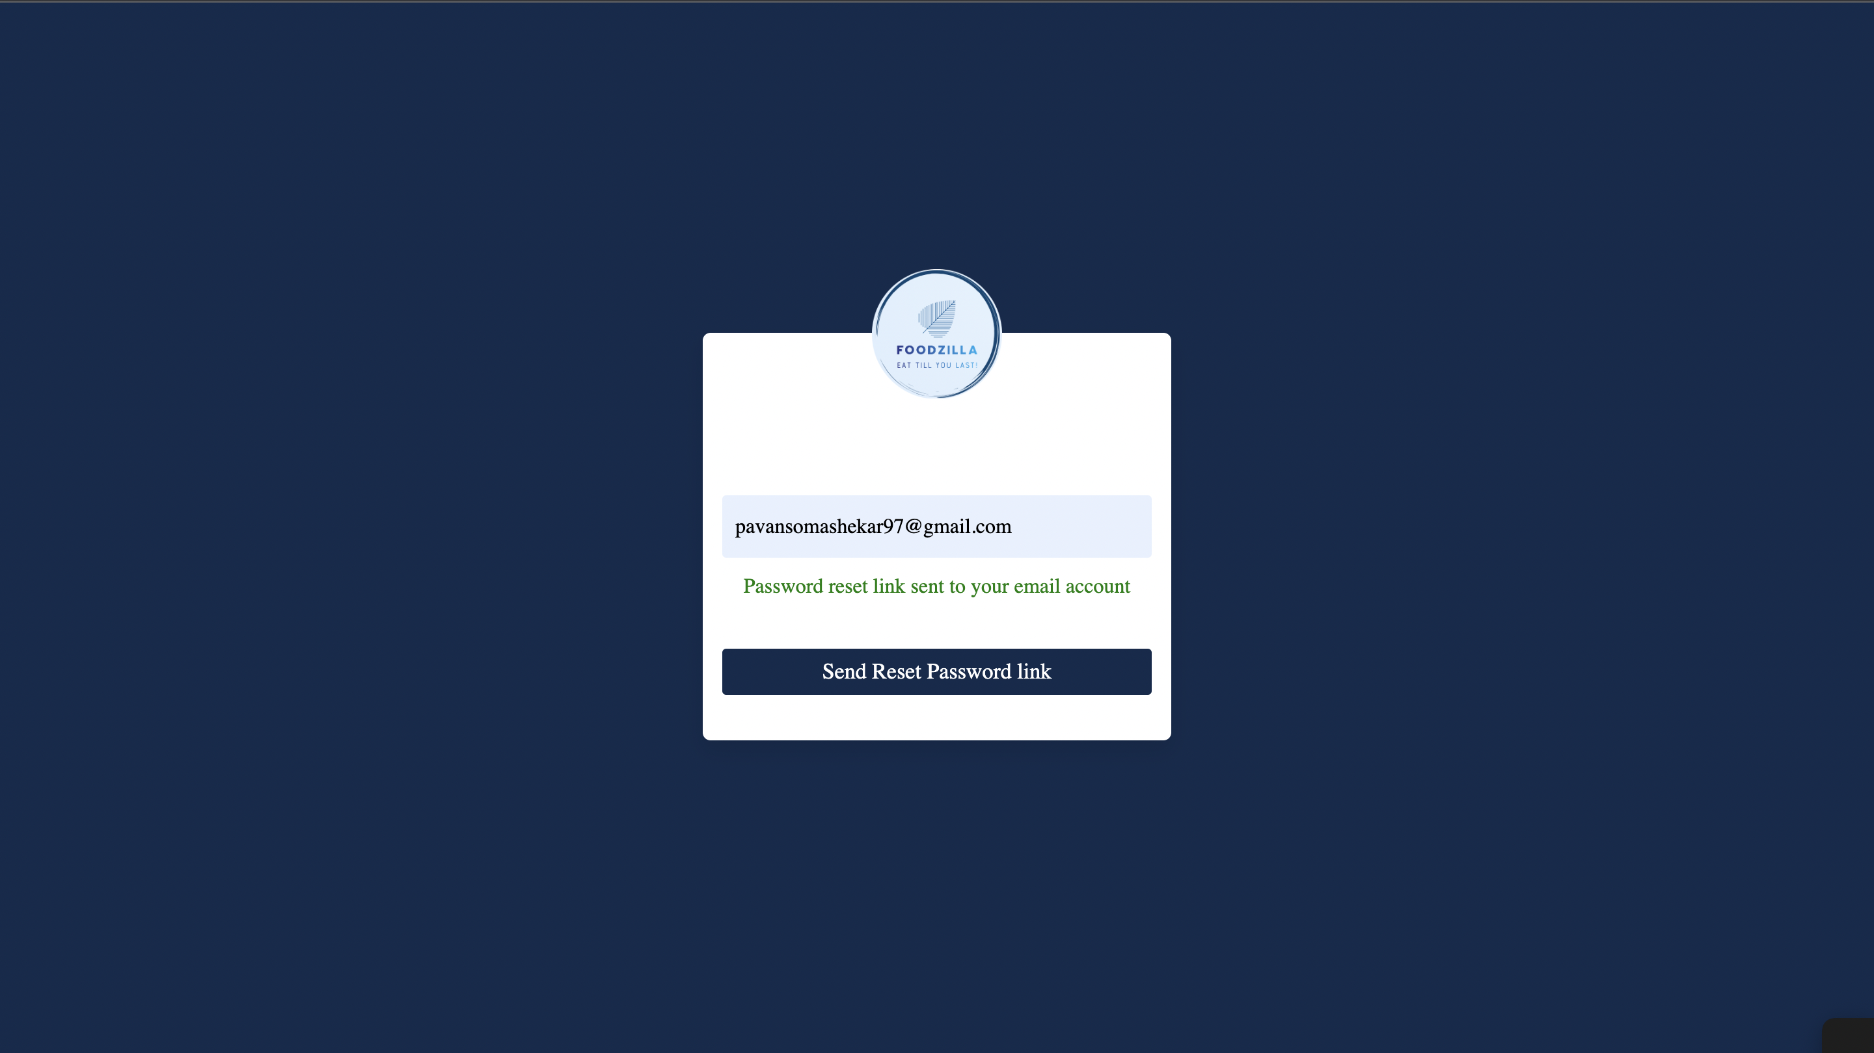

Slide 17
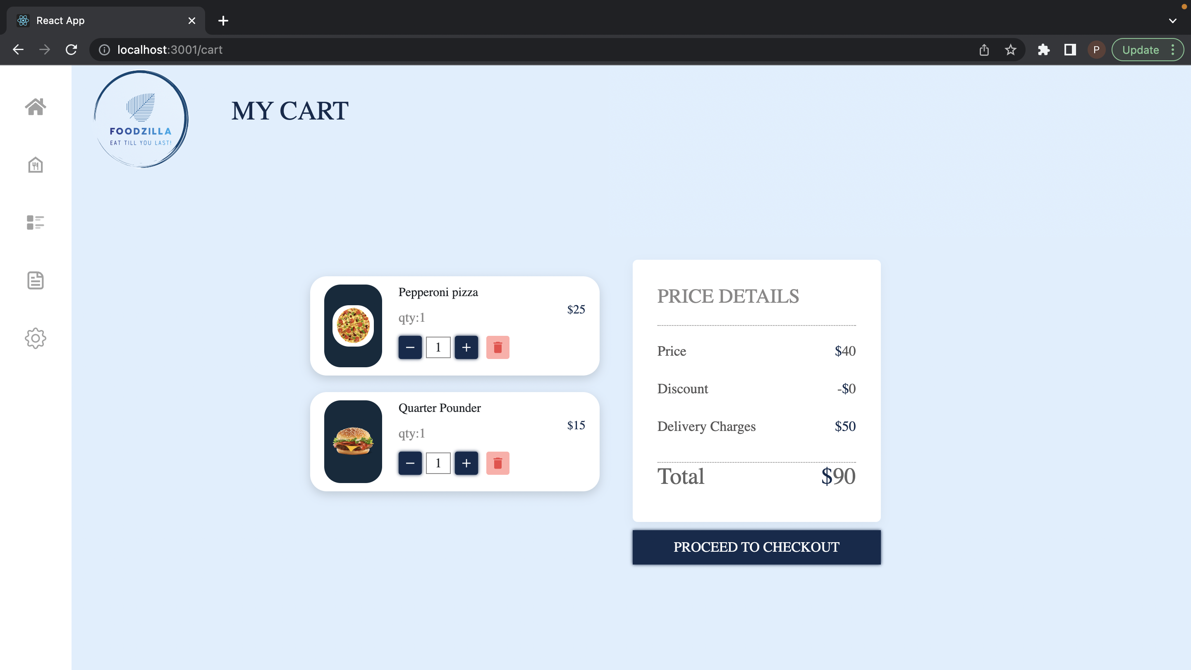

Slide 18
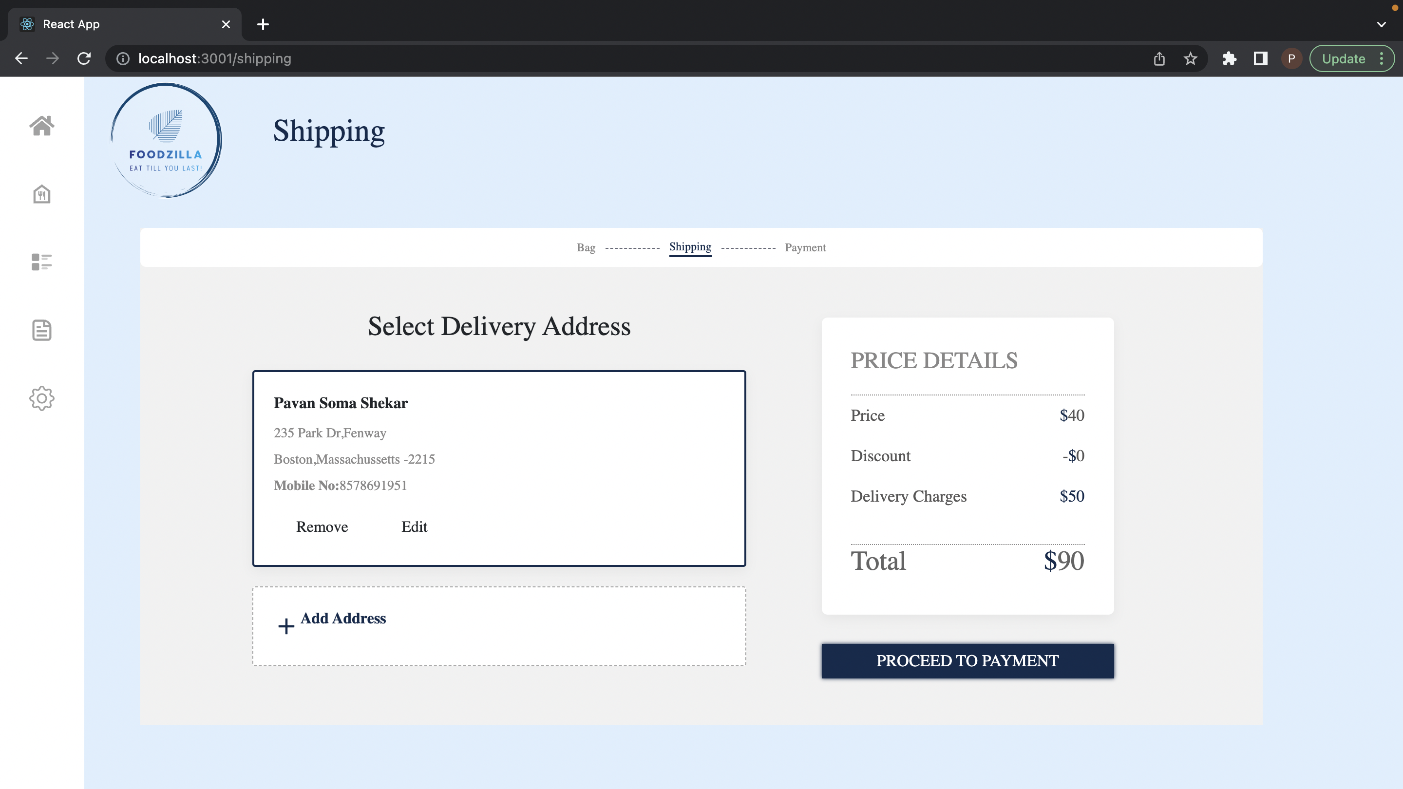

Slide 19
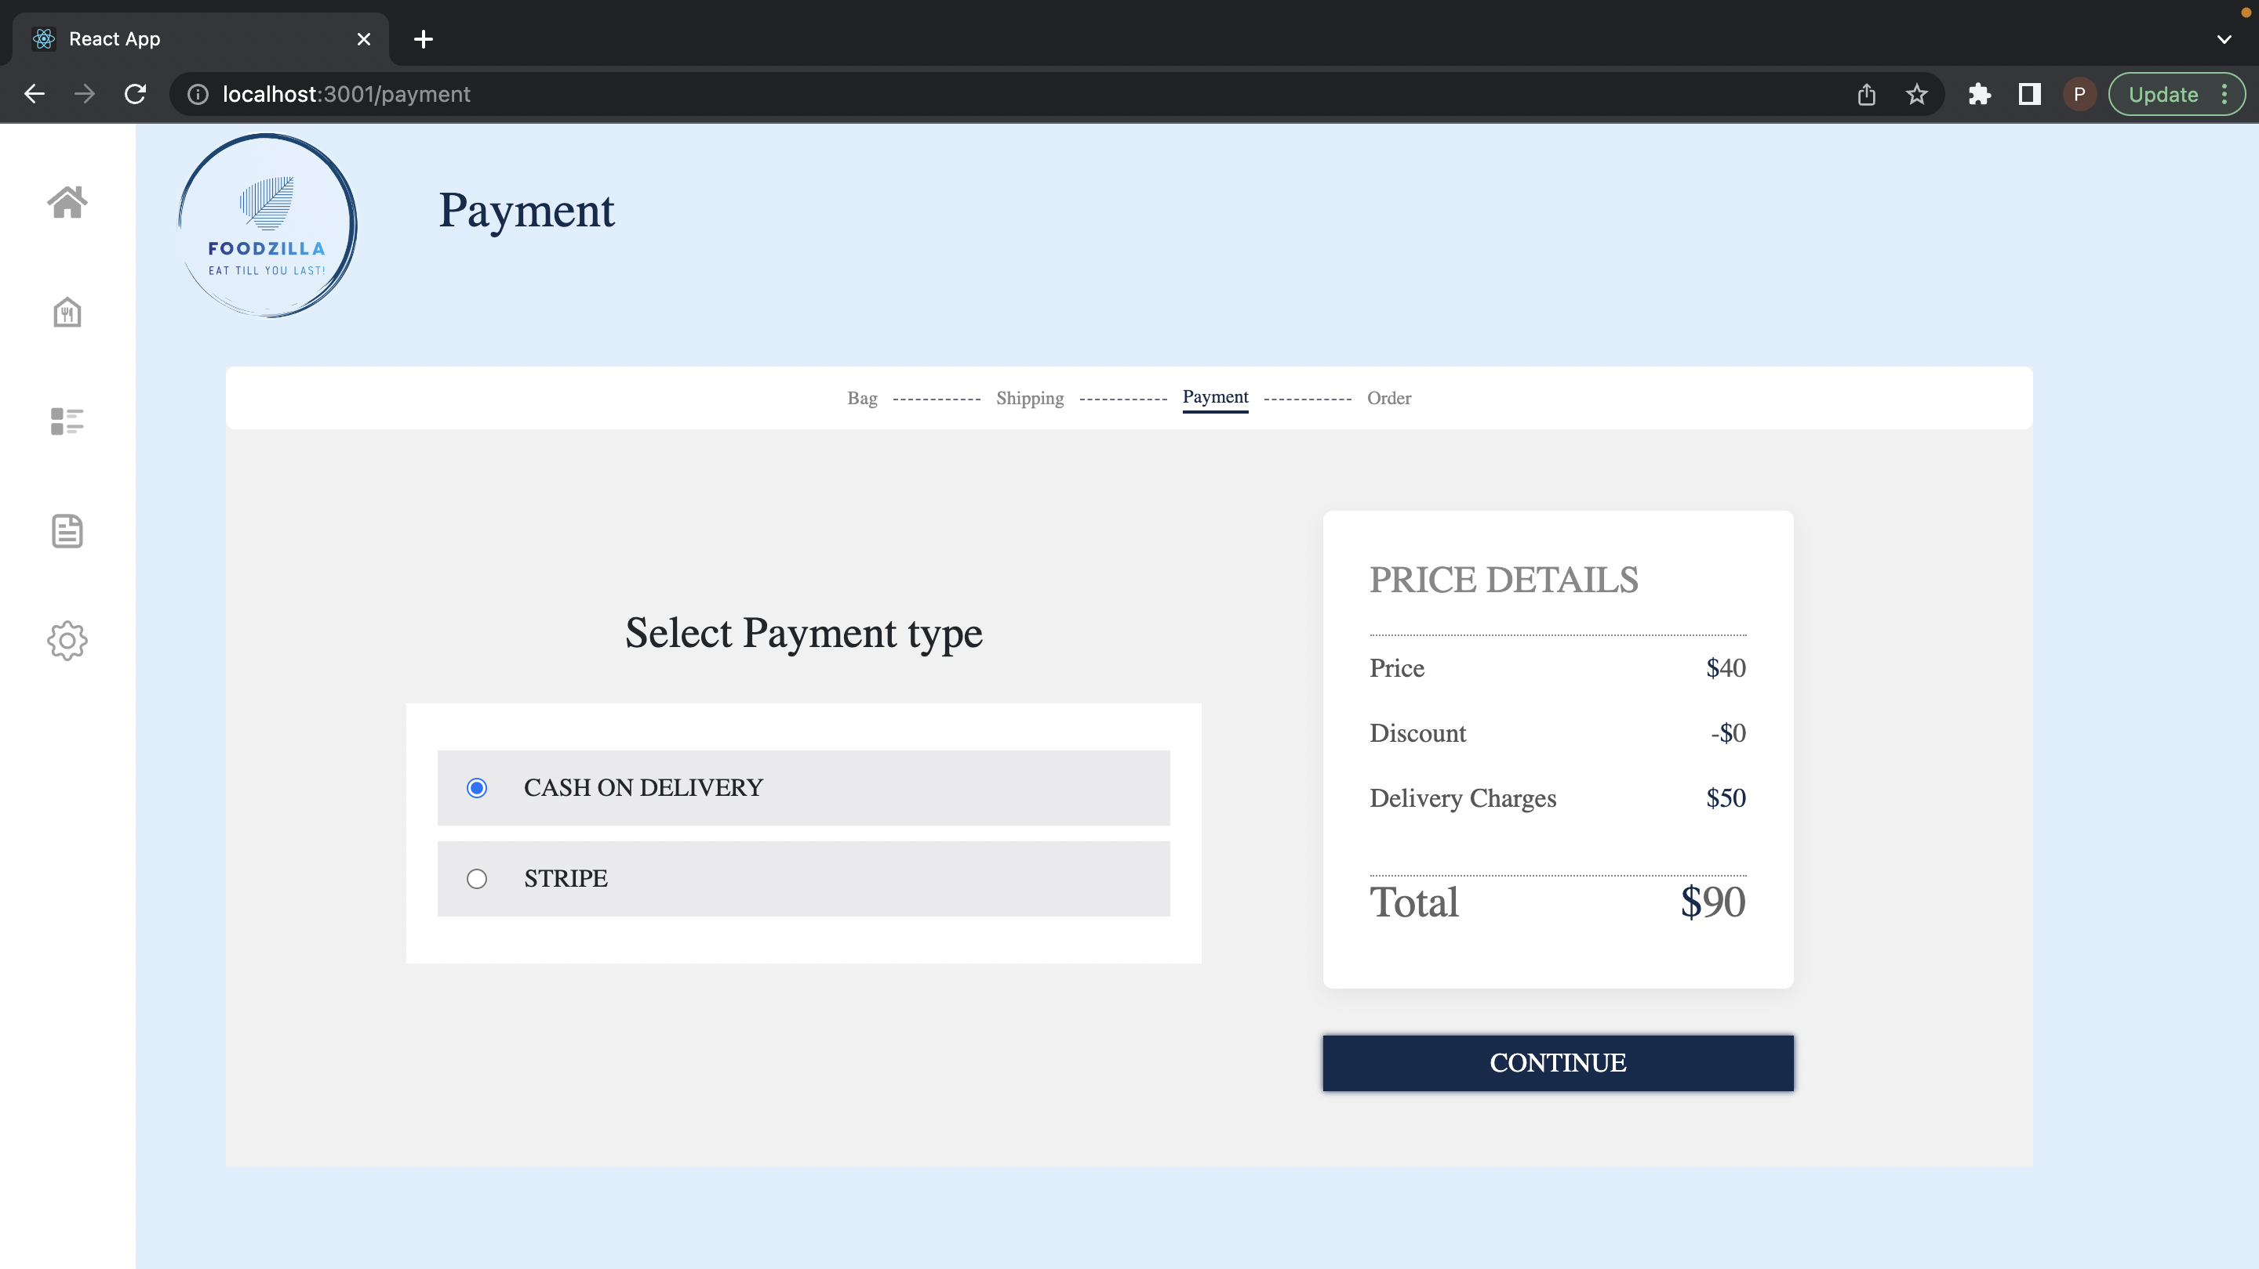

Slide 20
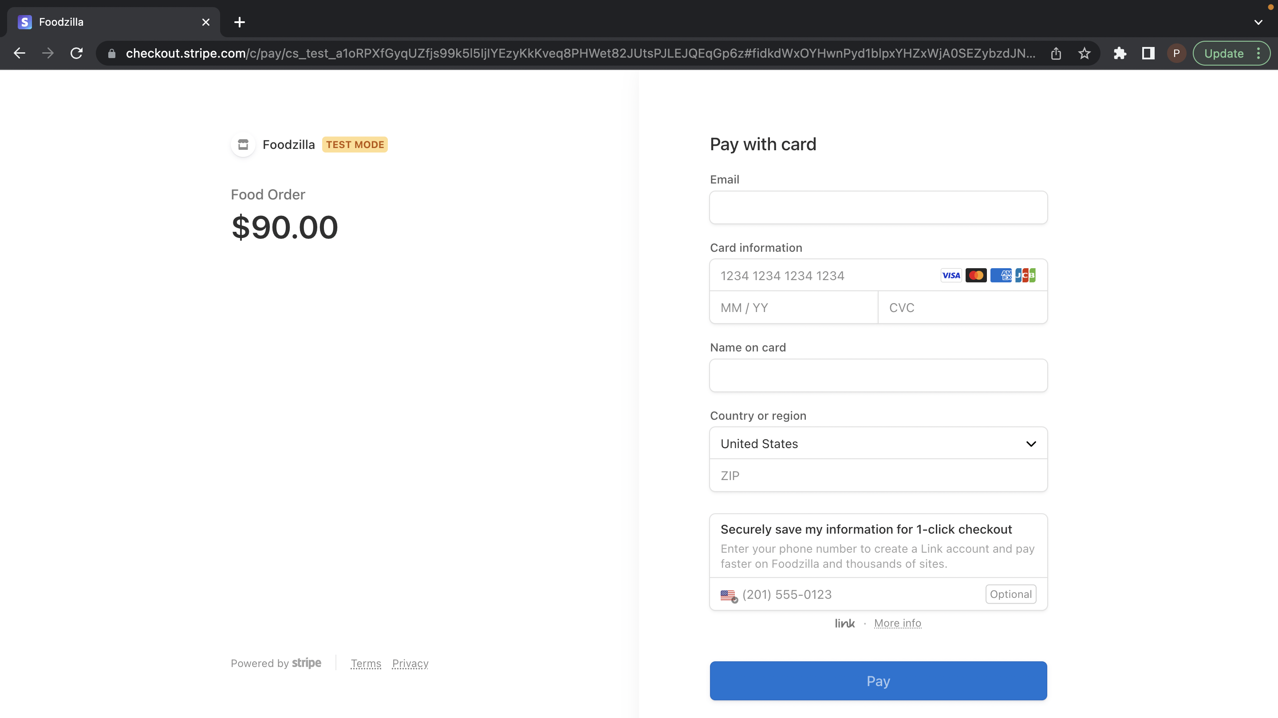

Slide 21
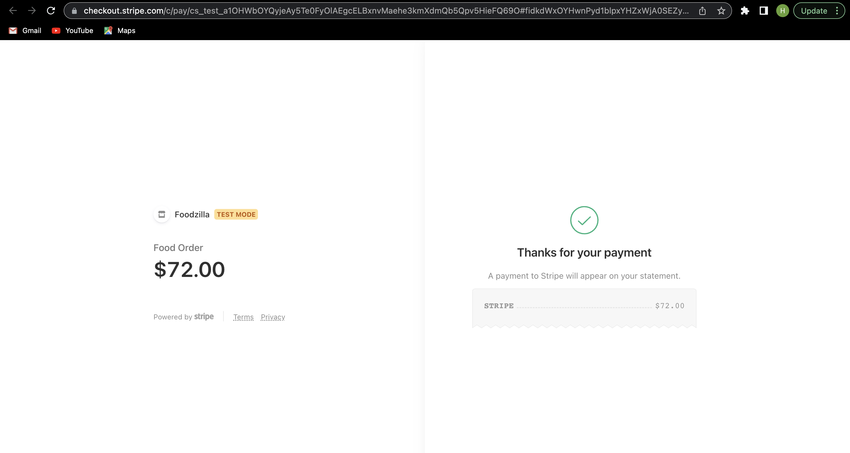

Slide 22
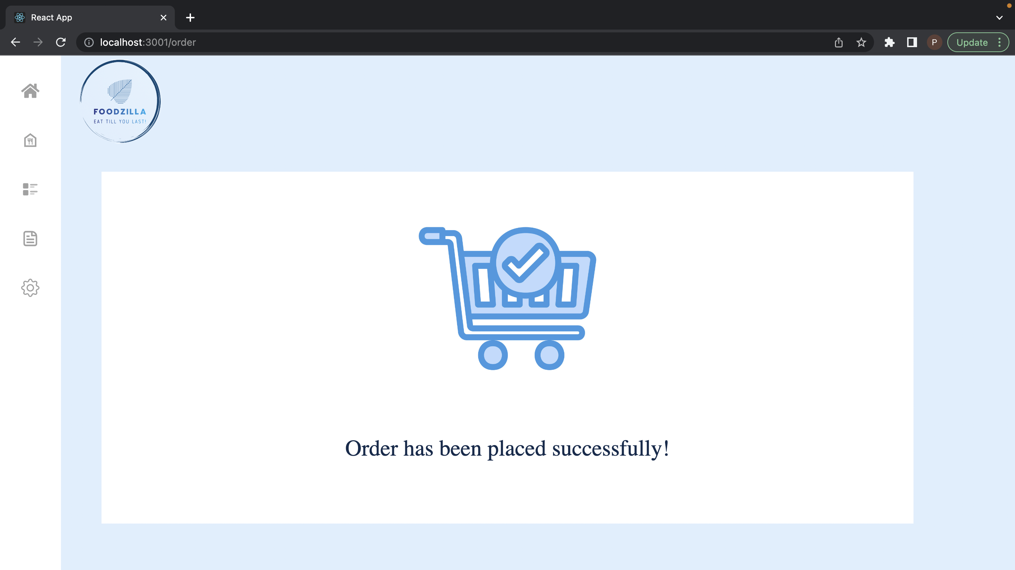

Slide 23
Signed in as an Admin

Slide 24
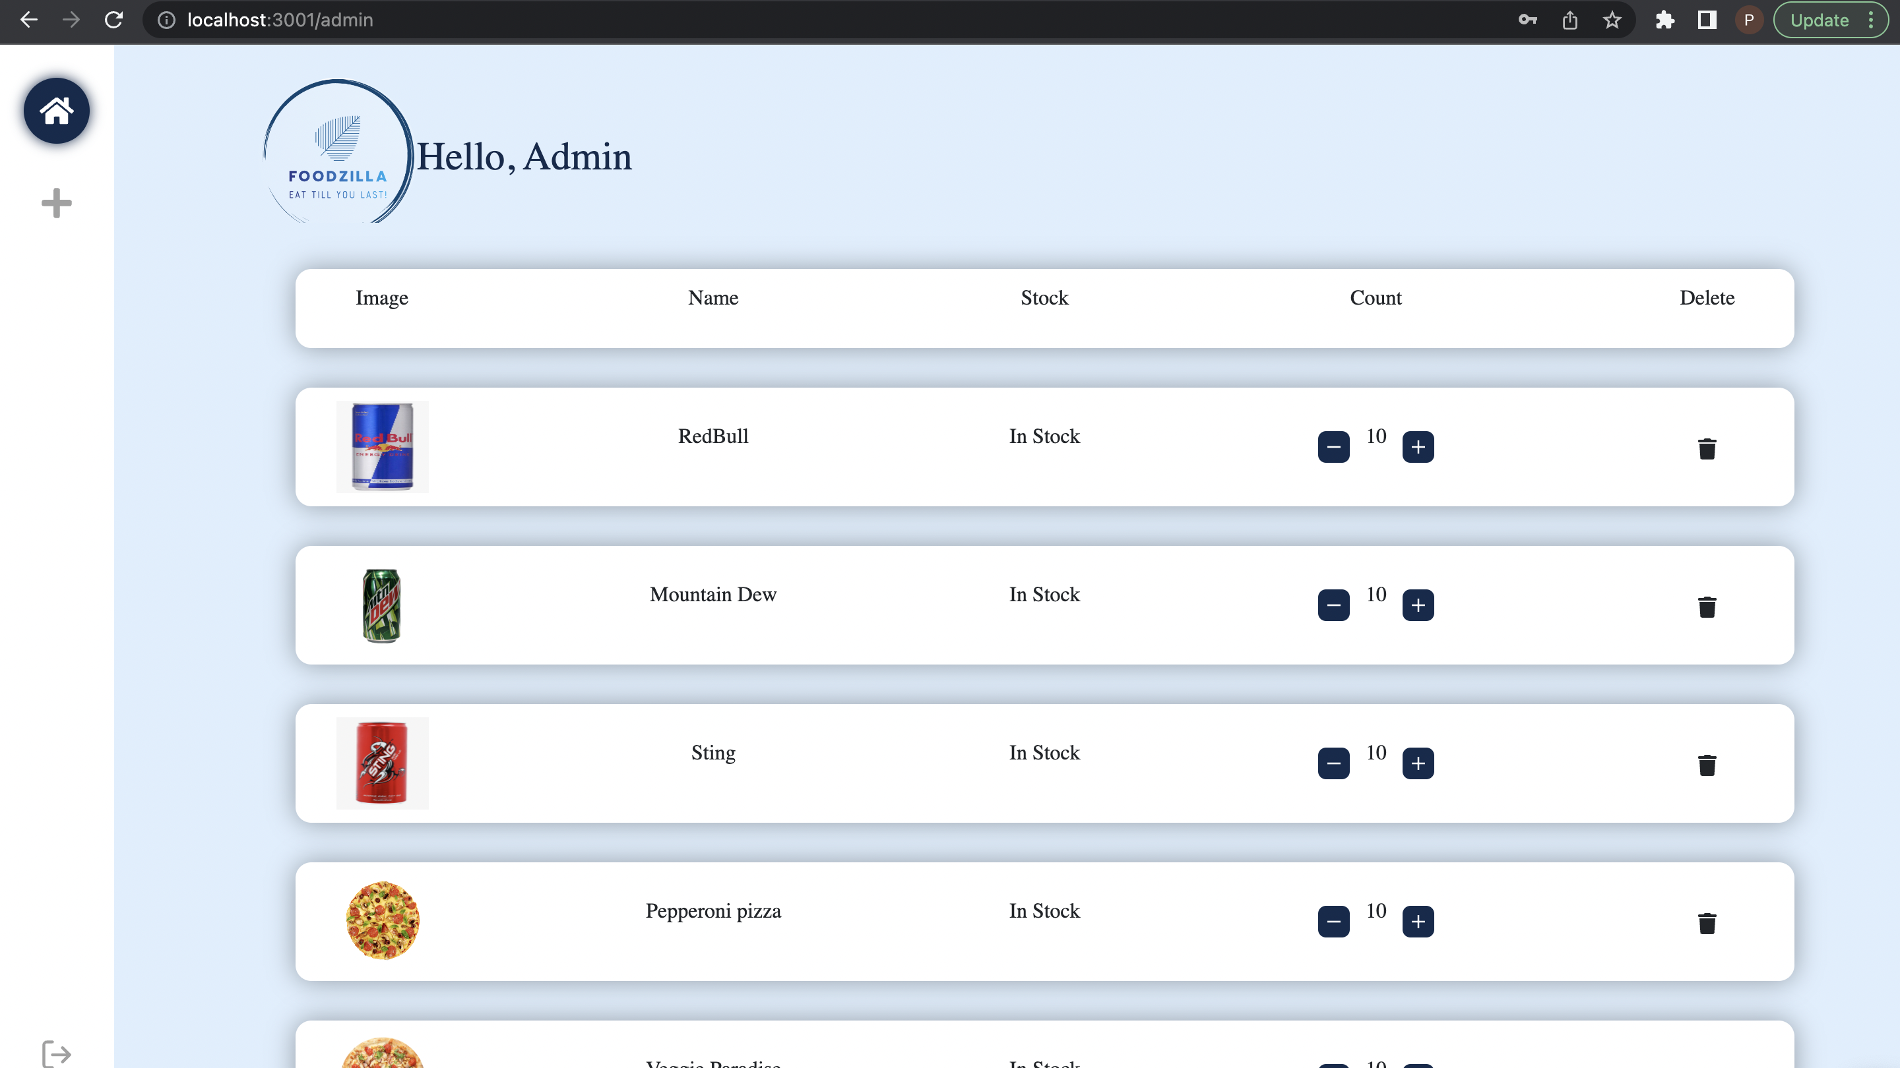

Slide 25
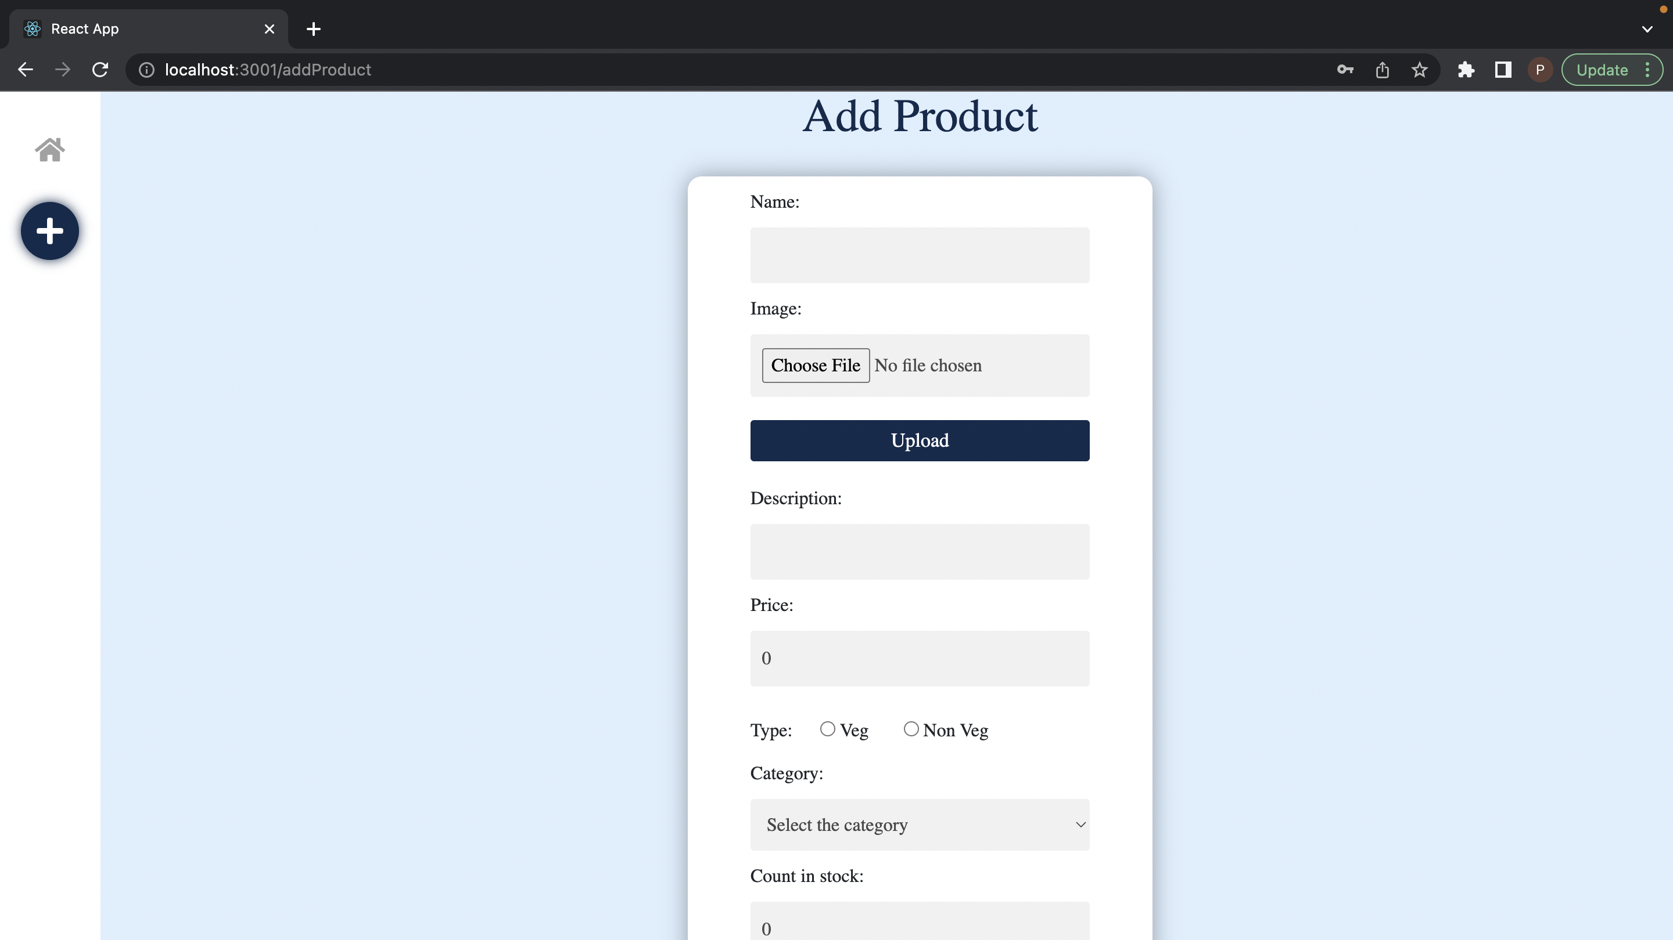

Slide 26
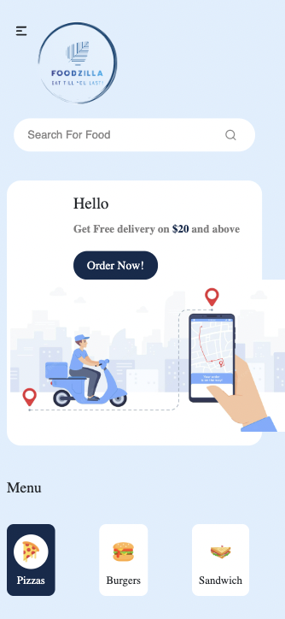
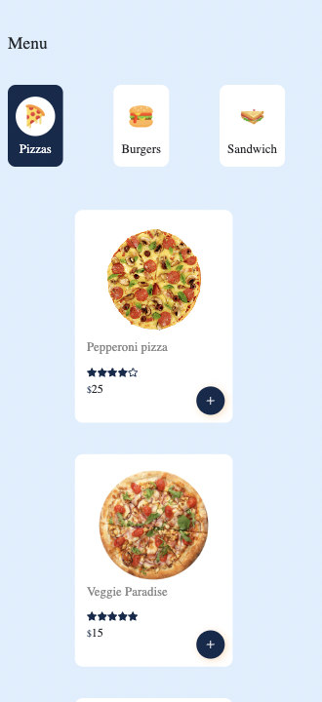
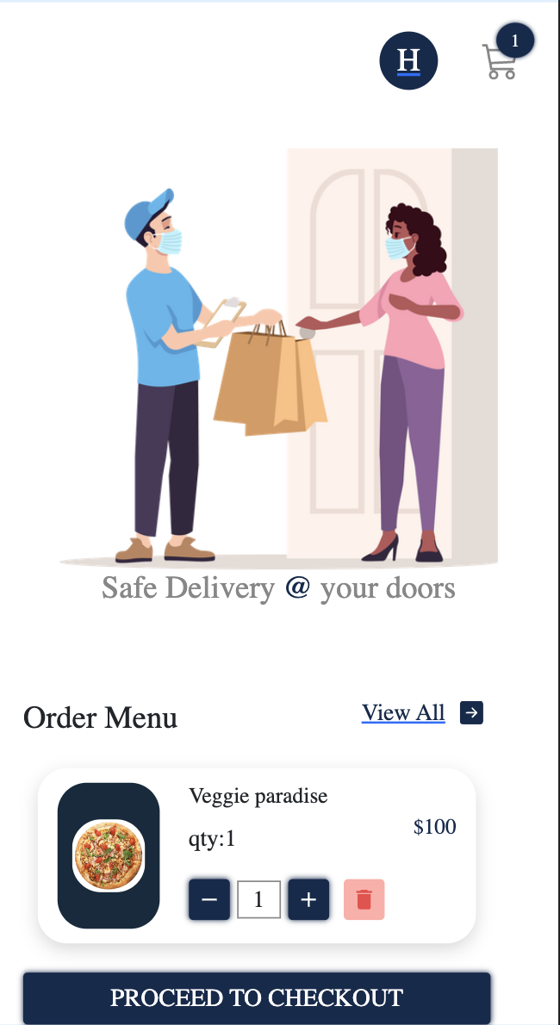
Responsive Behavior

Slide 27
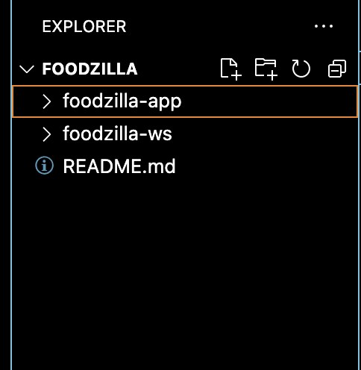
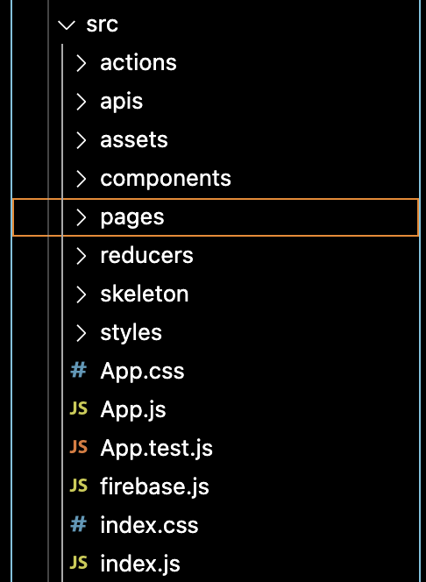
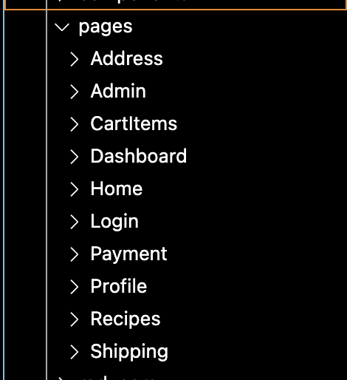
Folder Structure

